Slide 1
Interdisciplinary Collaboration: Achieving a Common Semantic Fabric
Philip R.O. Payne, Ph.D.
Assistant Professor, Department of Biomedical Informatics
Director - Biomedical Informatics Program, Center for Clinical and Translational Science
Co-Director - Biomedical Informatics Shared Resource, Comprehensive Cancer Center
Translational Research Informatics Architect, The Ohio State University Medical Center

Slide 2
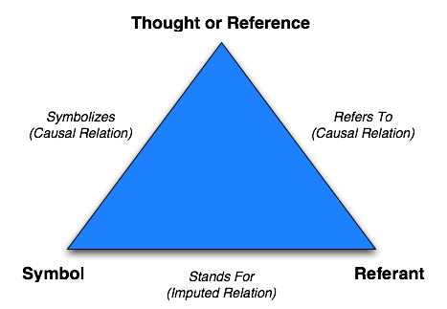
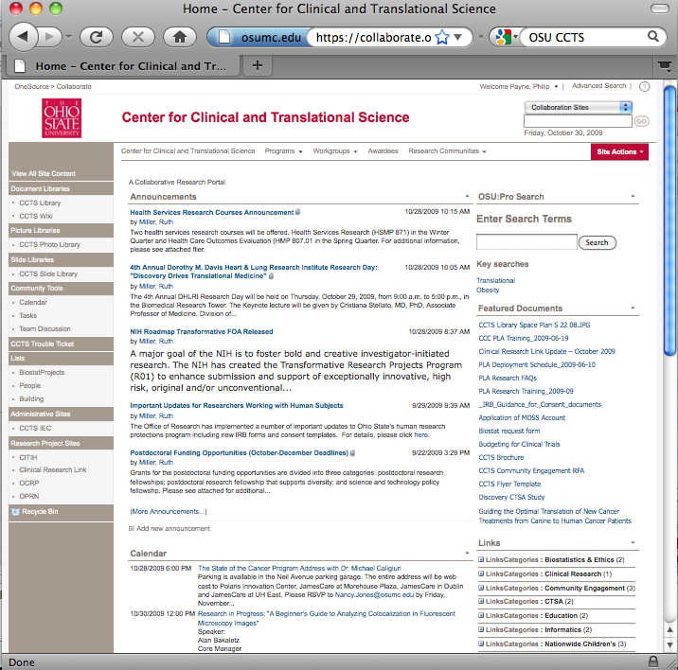
Key Points
Semantics: intended or perceived meaning of symbols corresponding to conceptual entities
Defined by discipline of semiotics and cognitive psychology
Two type of semantic interoperability: computable vs. working
Semantics must be addressed at a systems level:
Individuals
Organizations
Technologies
Example case illustrating the challenge of creating a common semantic “fabric”
Design of CCTS collaboration portal
Application of CKE methods to design
Technology limitations
Implementation team mismatch
Socio-technical barriers to adoption
Poor uptake and utilization
Fundamental problem = semantic mismatch between information needs, developers, and technology platforms

Slide 3
Health Informatics
Nursing Informatics
Computers in Medicine
Medical Informatics
Computational
Biology
Imaging Informatics
Bioinformatics
AI in Medicine
Public Health
Informatics
Biomedical Informatics

Slide 4
Advice
For trainees:
Get engaged in the team science environment
Approach research and development efforts in this space with a systems orientation
Be aware of pertinent frameworks and theories
Semiotics
Cognitive Science
Be willing to challenge conventions
Current team science environment is very immature
For individuals new to the healthcare domain:
Be aware of sub-culture and its implications
Place work in context of motivating scientific, clinical, and operational use cases
Technology for technologies sake does not sell well to funders or adopters
Champions are critical!
Error towards simplicity (the best solutions are rarely complicated)
Problem decomposition
Simplification of workflows and processes borne of necessity and historical precedent

Slide 5
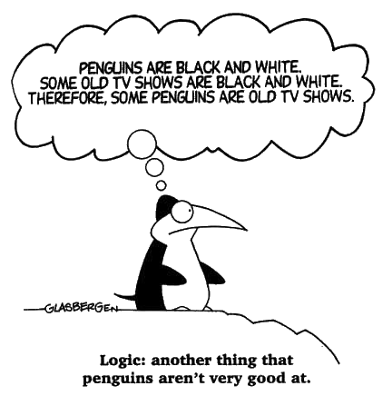
Issues To Think About…
Lack of cultural and workflow awareness
Poor understanding of applicable theories, frameworks, and prior work
Example: Semiotics – semantics – cognitive science – knowledge engineering
Appropriate use and limits
Absence of
motivating use cases
Systems level approach
Realism vs. instrumentalism

Slide 6
Questions/Comments?
Thank you for your time and attention
philip.payne@osumc.edu
http://www.bmi.osu.edu/~payne

